Slide 1
Group 5-Third Individual Meeting
INTERFACING LCD DISPLAY AND BEAGLEBONE BLACK
Professor: Mike Aleshams
Presenter: Soumya Thazhathu Panchickal
(C0753009)

Slide 2

CONTENTS
Block diagram
Hardware and software used
Interfacing lcd and Beaglebone black
Schematic capture
Connection details
Coding
Conclusion
References

Slide 3
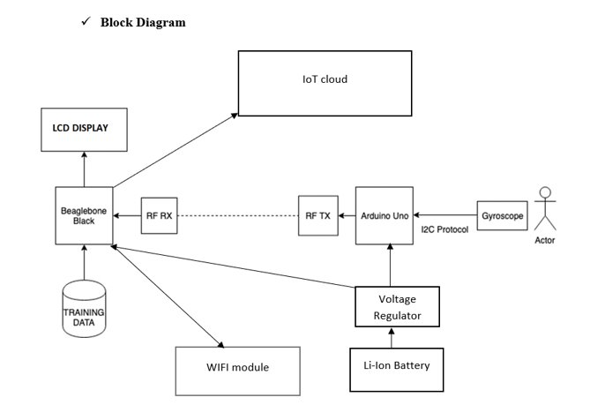
BLOCK DIAGRAM

Slide 4
HARDWARE AND SOFTWARE USED FOR INTERFACING
Beaglebone black
LCD Display
Connecting wires
Putty
PSFTP
Nano editor
GCC compiler

Slide 5
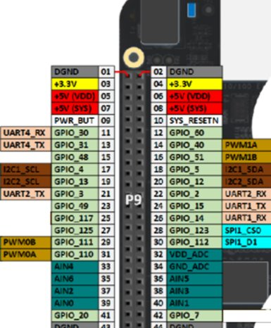
BEAGLEBONE BLACK
i2c protocol is used to interface beaglebone black
We are using i2c-2 bus of the beaglebone black to interface with lcd display
Beaglebone black has three i2c buses:
i2c0: Not exposed in the expansion headers
i2c1: pins P9 17,18 (and 24,26)
i2c2: pins P9 19,20 (and 21,22)

Slide 6
LCD DISPLAY
16*2 LCD display is used in our project
It consists of two rows and can print 16 characters in each row
i2C communication protocol is used for interfacing lcd with bbb
Operating voltage is 5V
LCD has i2C attached behind it with pcf8574 module soldered
Brightness can be adjusted using the potentiometer attached to the back

Slide 7
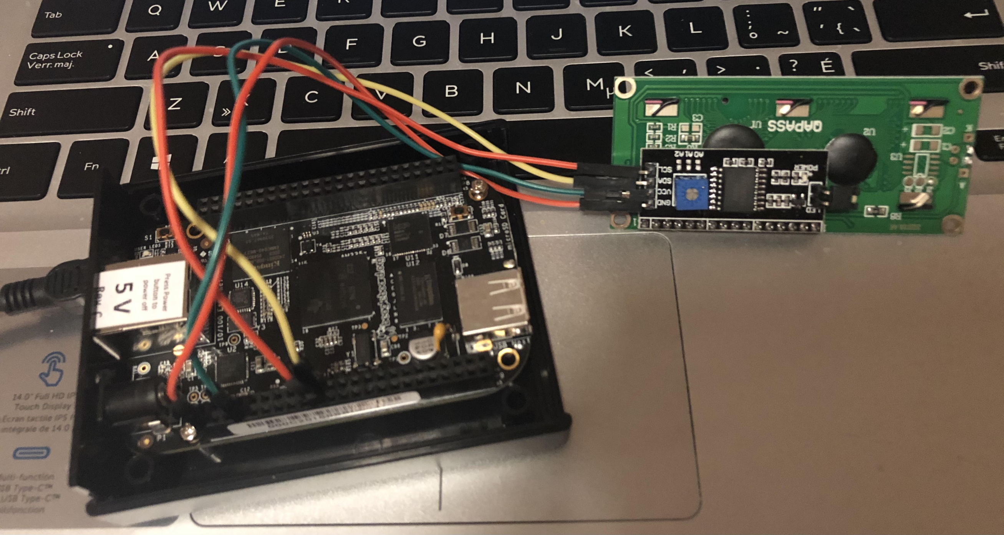
INTERFACING LCD WITH BEAGLEBONE BLACK
LCD is connected to beaglebone black using connecting wires
I2c protocol is used for the connection, thus less wires are required
Interfacing is done in 4 bit modes

Slide 8
INTERFACING IN 4 BIT MODE
DL: Interface data length control bit
When DL = "High", it means 8-bit bus mode with MPU.
When DL = "Low", it means 4-bit bus mode with MPU.
When 4-bit bus mode, it needs to transfer 4-bit data by two times.
N: Display line number control bit
When N = "Low", it means 1-line display mode.
When N = "High", 2-line display mode is set.
F: Display font type control bit
When F = "Low", it means 5 x 8 dots format display mode
When F = "High", 5 x11 dots format display mode.

Slide 9
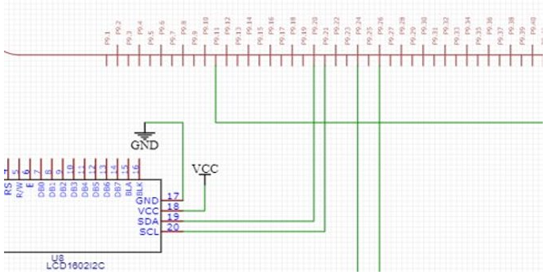
SCHEMATIC CAPTURE

Slide 10
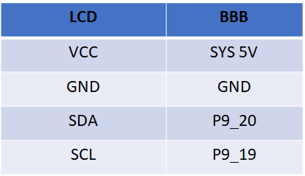
LCD AND BEAGLEBONE BLACK CONNECTIONS

Slide 11
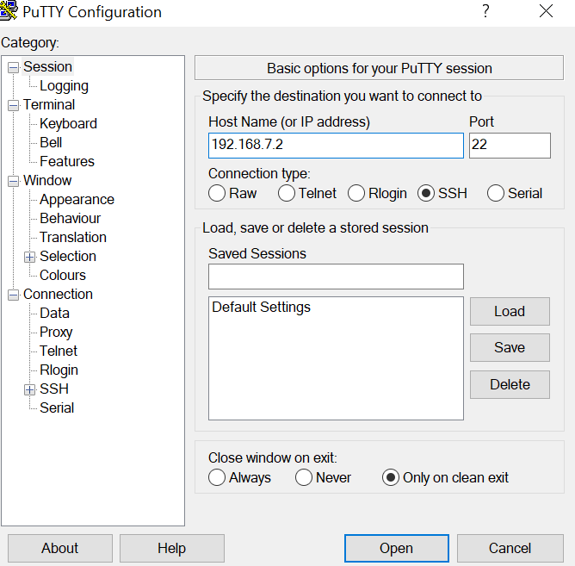
PuTTy
PuTTY is a free and open-source software for Windows devices that gives users the option to transfer data securely and safely
SCP, SSH, SFTP, and Rlogin are the protocols used to encrypt data and protect it from unauthorized use.
This software allows users to connect to switches, routers, mainframes, and servers via SSH and serial clients.
In order to use beaglebone, first we need to log in to it. Open putty and enter the ip address of beaglebone black.

Slide 12
PSFTP
PSFTP is the Secure File Transfer Protocol (SFTP) client of PuTTY
PSFTP in windows is similar to SFTP in linux
PSFTP is used in the following ways:
Download the psftp.exe file and open the command prompt
Use the psftp debian@192.168.7.2 and then type the default debian password: temppwd
Now go to PuTTY and login to beaglebone black
Type the ls command and see the files inside beaglebone black

Slide 13
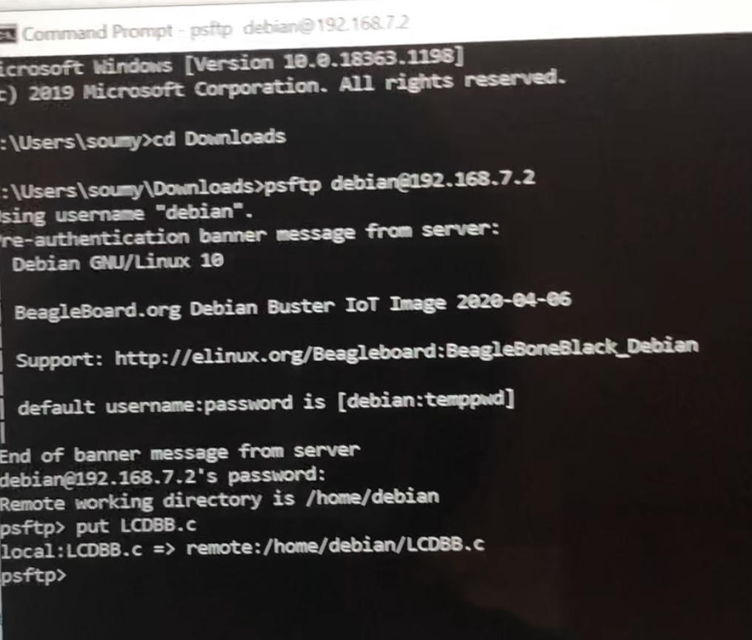
Contd.....
When you find the list of files in beaglebone black which has the lcd file
Go back to the command prompt
Use 'put' command: put "filename"
Here you are uploading the file in psftp.exe

Slide 14
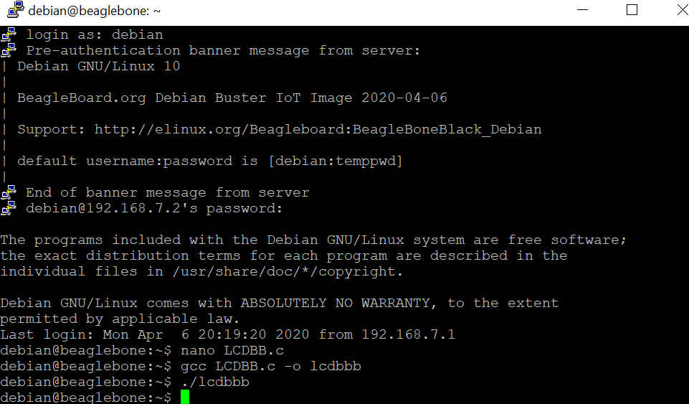
NANO is a text editor for command line interface
GCC is a standard compiler supporting many programming languages
The command used is gcc program name.c -o filename
gcc -o writes the build output to an output file.

Slide 15
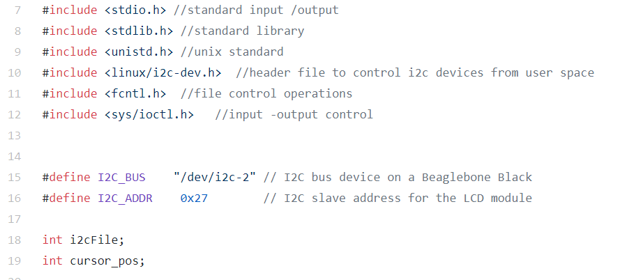
CODING
Stdio.h is used for defining variables and to perform input-output operations
Stdlib.h defines variable types and performs general function
Unistd.h is used for function like usleep()
Linux/i2c-dev.h for interfacing i2c devices
Fnctl.h for file operations
Ioctl.h is used to set the configuration of device

Slide 16
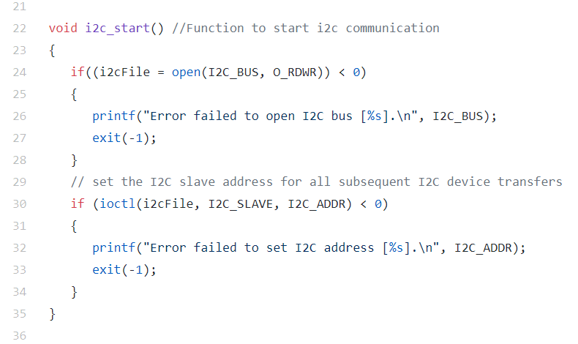
I2c function
I2c start() starts the i2c communication which opens the bus in read,write mode to communicate with the devices
The value must be greater than zero in order to open the i2c bus
Ioctl is for system call which should be greater than zero, so as to set the i2c address to communicate

Slide 17
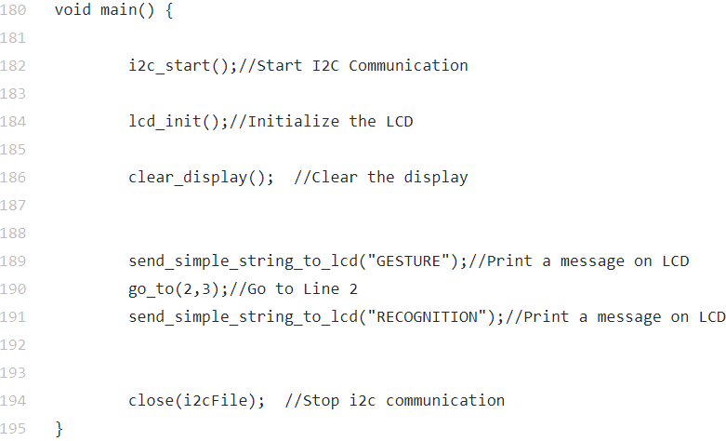
Main function
This is the main function that calls other functions
I2c communication is established first
Then lcd is initialized
Print the particular message according to the line mentioned using go_to function
I2c communication is finally closed

Slide 18
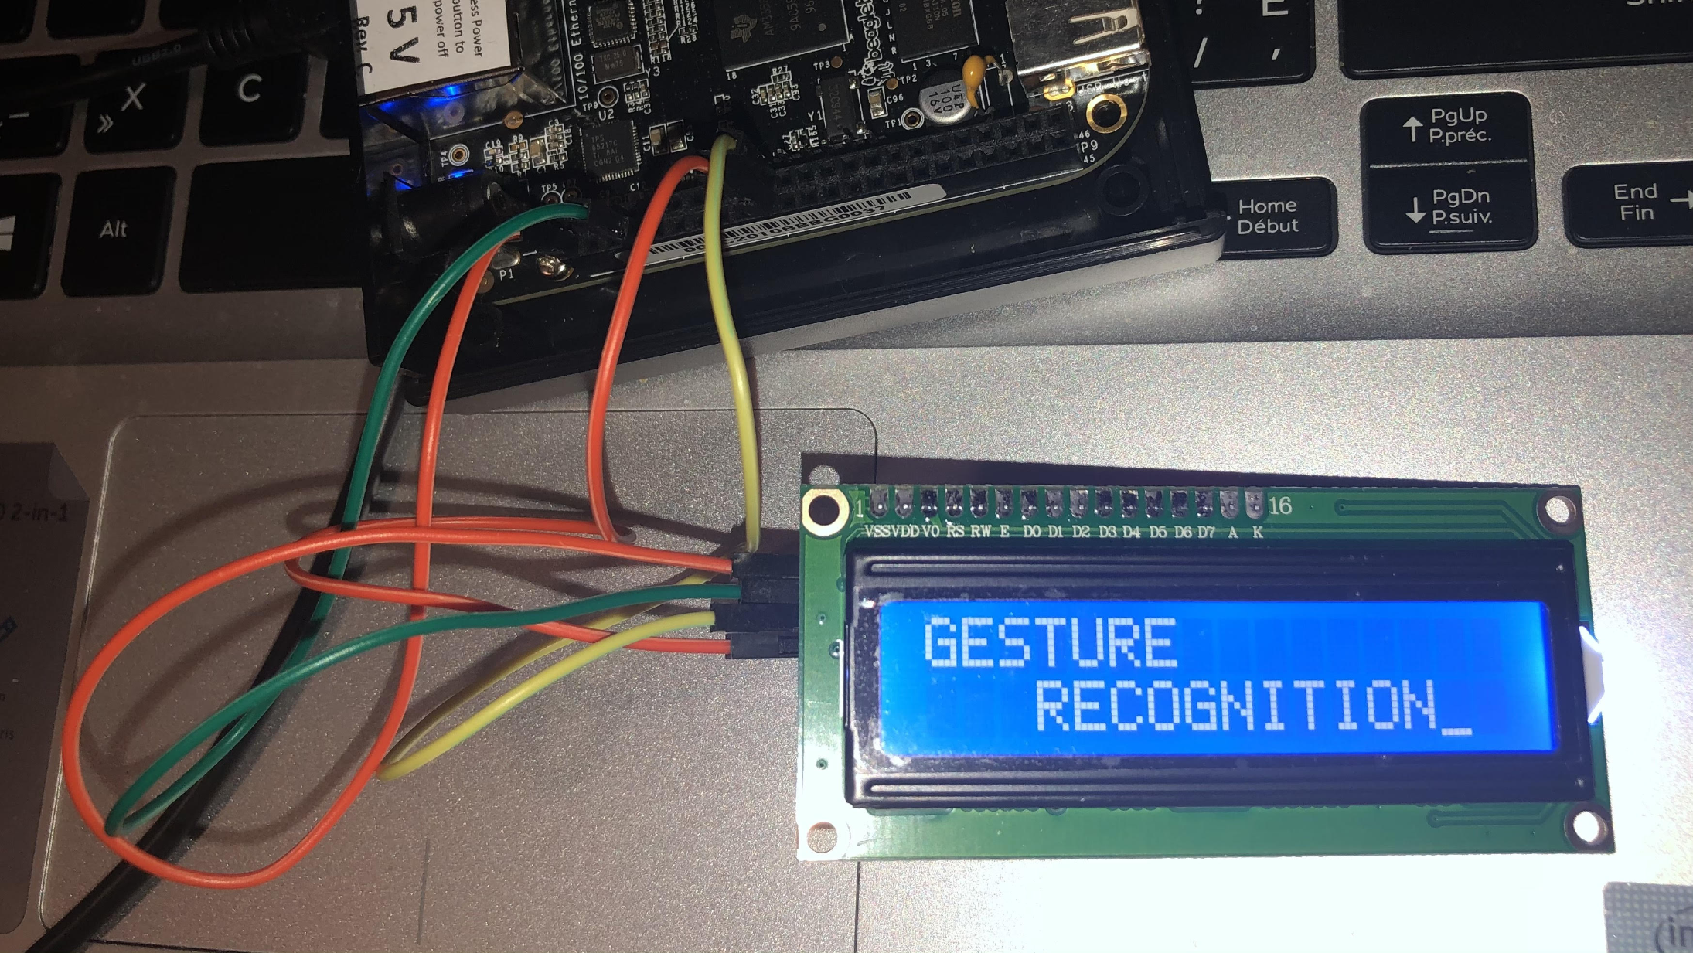
CONCLUSION
INTERFACING 16*2 LCD DISPLAY WITH BEAGLEBONE BLACK USING I2C PROTOCOL IS SUCCESSFULLY COMPLETED

Slide 19
REFERENCES
LCD module user manual(n.d). Retrieved november 20,2020 from https://panda-bg.com/datasheet/2134-091834-LCD-module-TC1602D-02WA0-16x2-STN.pdf
Putty(n.d). Putty. Retrieved november 20,2020 from https://putty.en.softonic.com/?ex=CORE-139.0
Beaglebone(n.d). Enable the i2c devices on beaglebone black. Retrieved november 20,2020 from http://beaglebone.cameon.net/home/i2c-devices
Instructables(n.d). Use 16x2 LCD With I2C. Retrieved november 19,2020 from https://www.instructables.com/LCD-With-I2C/
Puttygen(n.d). Psftp. Retrieved november 10,2020 from https://www.puttygen.com/psftp

Slide 20
CONTD...
Datko.J(2013, November 03). Beaglebone black i2c reference. Retrieved november 19,2020 from https://datko.net/2013/11/03/bbb_i2c/
Wikihow(n.d). Compile a c program using GCC. Retrieved november 20,2020 from https://www.wikihow.com/Compile-a-C-Program-Using-the-GNU-Compiler-(GCC)
Man7(n.d). Linux manual page. Retrieved november 21,2020 from https://www.man7.org/linux/man-pages/man0/unistd.h.0p.html

